Slide 1
_retailer_ Briefing Book

Slide 2
REPORT OUTLINE
Section | Key Questions Answered | Metrics Covered
Channel Performance & Trends | What share of trips are commanded by the different retailer Channels and Outlets within the target channel? | Share of trips by Retailer channels and Outlets. Share shift from previous year.
 | How has the share changed from the past year?
Who is the shopper? | What are the Key Demographic characteristics of the shopper? | Gender, Age, Ethnicity, HH Income, Parental Identification, Employment Status, Device Ownership, Primary shopper.
 | What are the Key Attitude Segments and Kohorts the shoppers belong to? Which Attitude Statements do they identify most closely with? | shopper Attitude Segments. Top 2 Box Attitude Statements. Kohorts distribution.
 | What other establishments/channels are frequented by this retailer’s monthly+ shoppers? | Cross Frequency for channels and top retailers in each channel.
Path to Purchase and Trip Details | What is the Path to Purchase for trips to this retailer? What are the key characteristics of the trips? | Snapshot of P2P dashboard. Location Prior, Planning and Preparation, Trip Mission, Destination Items. Visit Motivations, Reasons for Store Choice Items Purchased, Impulse items, Expenditure, Checkout Method. Overall Satisfaction and Satisfaction with Different Attributes.

Slide 3
REPORT OUTLINE
Section | Key Questions Answered | Metrics Covered
Frequency Shares | How often do people visit this retailer? | Frequency distribution of shoppers within this retailer trade area, comparison with average of selected competitor set Frequency distribution of Yearly+ shoppers and Trips. Comparison with average of selected competitor set.
Strengths and Opportunities | What are the key shopper perceptions/ imageries about this retailer? Which are the strong attributes of this retailer and which can be improved? | Store Imageries for this establishment along with selected competitors. Strength and Weakness measured among competitors. Relative importance of different perceptions among frequent shoppers. Best in Class outlet for each imagery statement among competitors, Gap with this establishment
Beverage Section | What are the key Beverage Categories, Brands, Manufacturers and Ingredients consumed/purchased from this retailer? | Top Beverage Categories Top Beverage Brands Consumed among Key categories Beverage Consumption by Manufacturers Beverage Ingredients Purchased

Slide 4
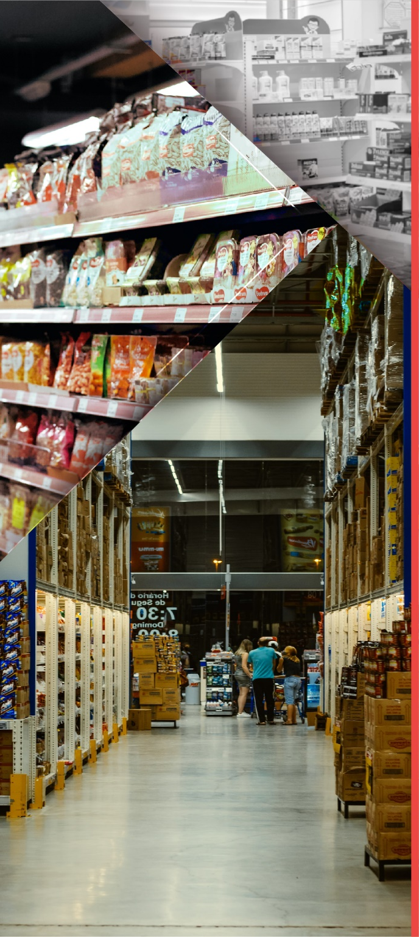


Channel Performance & Customer Trends
Retailer shopper Deep Dive
Who is the retailer shopper?
Path To Purchase and Trip Details
Frequency Shares
Strengths & Opportunities
Beverage Section

Slide 5
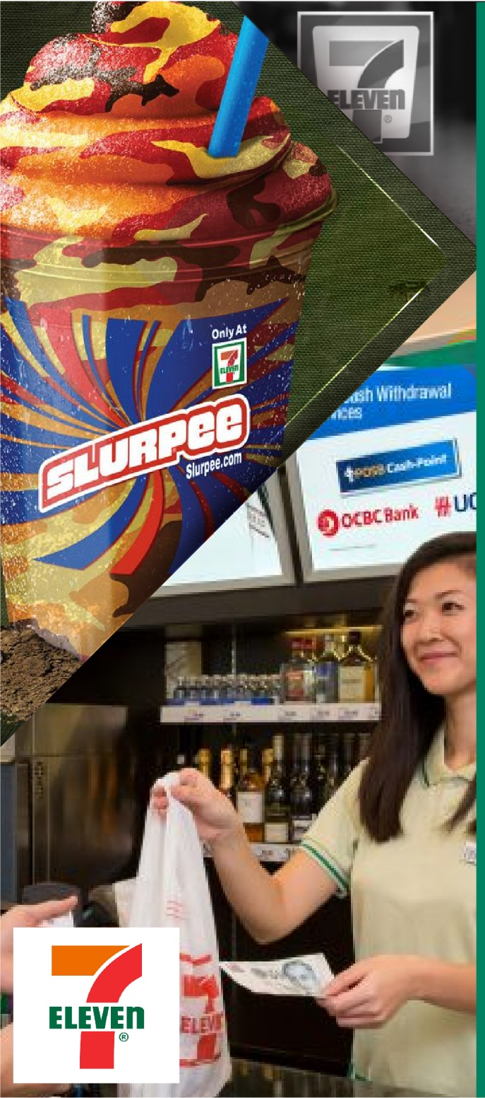
Channel Performance & Customer Trends
Retailer shopper Deep Dive
Who is the retailer shopper?
Path To Purchase and Trip Details
Frequency Shares
Strengths & Opportunities
Beverage Section

Slide 6


WHAT IS THE AVAILABLE SAMPLE SIZE ?
There are many lenses through which to dissect the _retailer_ shoppers and their trips, all with robust sample.
7 - Eleven
Monthly+ shoppers of _retailer_
Quarterly+ shoppers of _retailer_
Yearly+ shoppers of _retailer_
Visits
8,823
11,940
19,789
1,485
% of Convenience
41.9%
41.6%
49.9%
33.2%
Time Period: _timeperiod_

Slide 7


WHAT IS THE MARKET SHARE OF CHANNELS AND HOW DID IT SHIFT?
Notable Gains
GAINING
Supermarket/ Grocery
Share Change: _shareChange_
Visit Share: _visitChange_
LAGGING
Notable Loss
Club
Share Change: _shareChange_
Visit Share: _visitChange_
Indicates significant change at 95% confidence
Source: iShop | Base: Total Trips
Time Period: _timeperiod_ | Freq – _frequency_

Slide 8


WHAT ARE THE TOP RETAILERS IN THE CHANNEL?
Notable Gains
GAINING
LAGGING
Share Change: _shareChange_
Visit Share: _visitChange_
Notable Loss
Share Change: _shareChange_
Visit Share: _visitChange_
Indicates significant change at 95% confidence
Source: iShop
Time Period: _timeperiod_ | Freq – _frequency_
Notes:
Share of QSR

Slide 9
Channel Performance & Customer Trends
Retailer shopper Deep Dive
Who is the retailer’s shopper?
Path To Purchase and Trip Details
Frequency Shares
Strengths & Opportunities
Beverage Section

Slide 10






WHAT IS YOUR SHOPPERS DEMOGRAPHIC PROFILE?
Gender
Age Group
Ethnicity
Males
Index v
_base1_
Index v
_base2_
Ethnicity
Index v _base1_
Index v
_base2_
Age Group
Index v _base1_ | Index v _base2_
93 | 101
14.6% | 13 – 18 yrs | 118 | 119
17.3% | 19 – 24 yrs | 129 | 118
23.6% | 25 – 34 yrs | 108 | 93
24.6% | 35 – 49 yrs | 92 | 96
15.6% | 50 – 64 yrs | 83 | 100
3.6% | 65 – 75 yrs | 55 | 57
55.0% | White | 98 | 105
20.6% | African American | 126 | 135
18.2% | Hispanics | 92 | 83
4.1% | Asian | 76 | 47
50.3%
Employment Status
Household Income
Parental Identification
Index v
_base1_
Index v
_base2_
Employment Status
HH Income Under $25K
Index v _base1_ | Index v _base2_
106 | 125
109 | 93
Parent of child <18 yrs in HH
20.0% | Student | 118 | 119
53.2% | Employed Full-time | 129 | 118
11.2% | Employed Part-time | 108 | 93
4.6% | Homemaker | 92 | 96
6.2% | Retired | 83 | 100
69.2% | White Collar | 55 | 57
19.1% | Blue Collar | 86 | 102
Index v _base1_ | Index v _base2_
85 | 83
22.3%
24.4%
$75K+
47.2%
Note: Significantly high / Significantly low
Source: iShop
Time Period: _timeperiod_ | Freq – _frequency_
10

Slide 11






WHAT IS YOUR SHOPPERS SEGMENTATION?
shopper Segments
Pleasure shoppers
Quality
Comparers
Social shoppers
Price
Seekers
Payday shoppers
Errand Runners
23.6%
19.0%
16.8%
14.8%
13.7%
12.0%
Index v
_base1_
92 | 102 | 117 | 121 | 107 | 95
Index v
_base2_
111 | 79 | 89 | 128 | 125 | 92
Primary shopper
Device Ownership
 | iPhone | Android Phone | iPad | Other Tablet | Amazon Echo/ Alexa | Google Home
7-Eleven | 51.8% | 52.8% | 36.7% | 34.7% | 32.5% | 10.6%
Index v _base1_ | 111 | 87 | 113 | 95 | 116 | 98
Index v _base2_ | 116 | 90 | 120 | 100 | 125 | 120
Index v _base1_ | Index v _base2_
99 | 125
78.7%
Note: Significantly high / Significantly low
Source: iShop
Time Period: _timeperiod_ | Freq – _frequency_

Slide 12
WHAT ATTITUDE SEGMENT DEFINES YOUR SHOPPERS?
Top 2 Box Attitude Statements (Top 10)
Kohorts Distribution
7-Eleven | Index v _base1_ | Index v _base2_
48.4% | 95 | 106
34.6% | 86 | 94
32.2% | 90 | 98
32.2% | 88 | 96
29.6% | 86 | 95
27.8% | 87 | 95
27.7% | 80 | 99
24.5% | 103 | 118
21.0% | 103 | 121
12.3% | 106 | 114
7-Eleven | Index v _base1_ | Index v _base2_
32.0% | 253 | 332
19.6% | 62 | 68
12.7% | 207 | 405
12.6% | 74 | 89
12.1% | 180 | 327
5.6% | 36 | 44
5.4% | 54 | 77
Look For Grocery Coupons/Deals On Internet
Compare Prices Between Stores
Choose Based On Price, Coupons, Discounts
Fixed Budget For Grocery Shopping
Wait Until Payday To Stock Up
Go More Than One Store Get Best Deal
Use Snap/Wic Help Pay For Items
Prefer Buy Organic Or Natural Foods
Intent Purchase Healthy, Buy Unhealthy
Prefer Buy High-Quality Products
Survivors
Aspirers
Givers
Providers
Age Defiers
Change Makers
Seekers
Source: iShop
Time Period: _timeperiod_ | Freq – _frequency_

Slide 13
















WHERE ELSE DO YOUR MONTHLY+ SHOPPERS FREQUENT?
TOP CHANNELS
Read as: _metric_ of monthly+ _selRetailer_ shoppers are also monthly+ shoppers to _channel_
75.7%
100.0%
68.9%
57.4%
29.7%
13.6%
Supermarket/ Grocery
Convenience
Drug
Dollar
Club
Online Grocery
TOP 10 Retailers
Read as:_metric_ of _selRetailer_ monthly+ shoppers are also monthly+ shoppers to _retailer_
55.8%
23.1%
44.1%
9.8%
9.8%
Albertsons
Circle K
CVS
Dollar General
Costco
35.7%
21.2%
25.1%
8.6%
7.9%
ALDI
Speedway
Walgreens
Dollar Tree
Sam’s Club
Source: iShop
Time Period: _timeperiod_ | Freq – monthly+

Slide 14
Channel Performance & Customer Trends
Retailer shopper Deep Dive
Who is the retailer shopper?
Path To Purchase and Trip Details
Frequency Shares
Strengths & Opportunities
Beverage Section

Slide 15



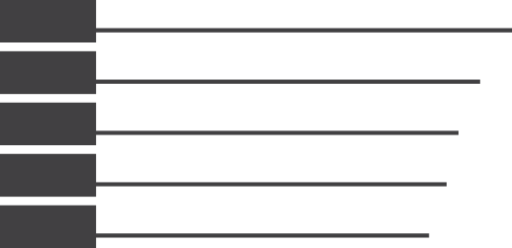











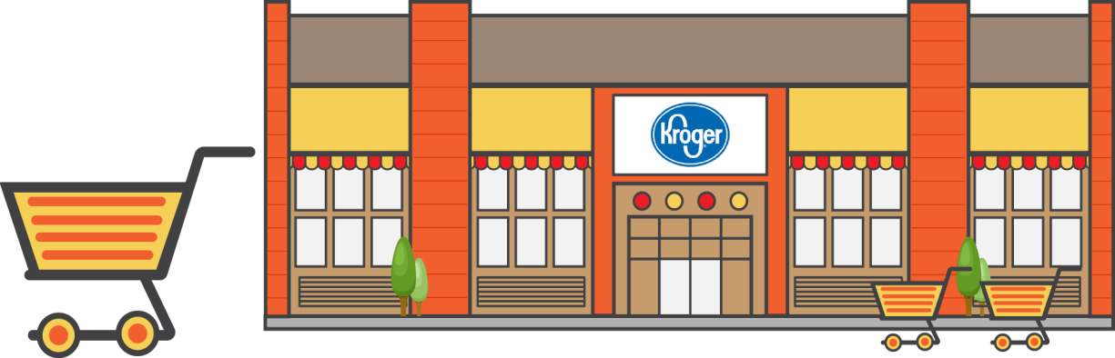
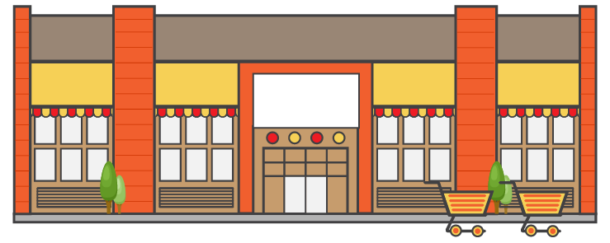






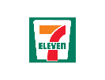
















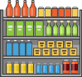





Path to Purchase | _retailer_|_timeperiod_
PRE-SHOP
PLANNING
TIME OF DAY
LOCATION PRIOR TO TRIP
-1.7
CONSIDERATION
WEEKDAY OR WEEKEND
36%
MORNING (6AM TO 11AM)
+3.1
_mp_
_metric_
-1.5
+0.8
_mp_
_metric_
_mp_
Weekday
16%
+2.8
-0.1
-1.1
_mp_
_metric_
_mp_
_metric_
MID-DAY (11AM TO 2PM)
15%
-3.2
-0.8
AFTERNOON (2PM TO 5PM)
_mp_
Weekend
21%
-1.1
EVENING (5PM TO 10PM)
12%
+2.2
WHO WITH
REASON FOR STORE CHOICE
NIGHT (10PM TO 6AM)
+3.9
+0.4
_mp_
_metric_
_mp_
_metric_
TRIP MISSION
SHOP
GRAB AND GO
DESTINATION ITEM
PURCHASED NARTD
36%
+4.0
+3.6
BASKET SUMMARY
GRAB AND GO HOME
_mp_
_metric_
+4.6
TOP ITEMS
31%
+6.4
+0.5
63%
-13.5
_mp_
_metric_
_mp_
_metric_
FILL IN NON-FOOD
17%
-9.3
-11.4
_mp_
_metric_
-2.5
OTHER
IMMEDIATE CONSUMPTION
(Consumed Within 1 hour)
_mp_
_metric_
16%
-1.0
+3.8
76%
+6.9
_mp_
_metric_
POST-SHOP
IC Food/Bev in Basket
NUMBER OF ITEMS
_mp_
_metric_
-0.1
OVERALL SATISFACTION
SATISFACTION DRIVERS
LOCATION AFTER TRIP
+1.1
TIME SPENT
_mp_
_metric_
DOLLARS SPENT
-0.2
4 – 5 MIN
37%
+2.7
$8
_mp_
_metric_
Average Per Basket
_metric_
_mp_
_metric_
_mp_
_metric_
_mp_
_metric_
_mp_
_metric_
_mp_
_metric_
_mp_
-1.4
+0.1
-0.9
-1.5
-1.6
-0.7
0.0
Source: CCNA iSHOP Tracker, Base - Total Trips, Sorted by: Largest Size, Time Period: _timeperiod_ Filters: _filter_
Sample Size – _ss_
* Stat tested at 95% CL against : _custom1_, Filters: _filter_
Classified - Confidential
15
Sample size in chart legend/label; Grey font = Low Sample (30-99)
Significantly Higher
Significantly Lower
15

Slide 16


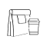

HOW DO SHOPPERS PLAN THEIR VISITS?
Location Prior
Trip Mission
Planning
Home
Large Stock-Up
Grab and Go
Need It Now
Visit Was Somewhat Planned
38.8%
32.7%
29.8%
21.1%
Index v _base1_
103
Index v _base1_
107
Index v _base1_
92
Index v _base1_
121
Index v _base1_
90
41.4%
Index v _base2_
98
Index v _base2_
106
Index v _base2_
85
Index v _base2_
135
Index v _base2_
92
Preparation Type
Top 3 Destination Items
Made A List
Searched For Coupons
Planned Specific Menu/Dish
Gasoline/
Diesel
Fresh Meat
Eggs
44.5%
20.5%
10.5%
44.5%
16.5%
15.4%
Index v _base1_
97
107
97
Index v _base1_
97
119
92
Index v _base2_
106
86
101
Index v _base2_
106
119
87
Note: Significantly high / Significantly low
Source: iShop
Time Period: _timeperiod_ | Freq – _frequency_
16

Slide 17
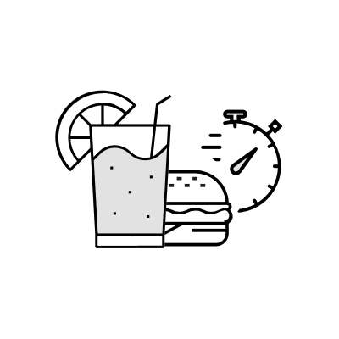









WHAT MOTIVATES YOUR SHOPPERS TO VISIT?
//
Reason For Store Choice Segment
Get a quick drink or snack
Take Advantage of Coupon/ Promo
Get In and Out Quickly
Buy Specific Items
Get The Best Everyday Value
78.5%
69.4%
51.5%
49.5%
33.3%
Index v _base1_
102
Index v _base1_
106
Index v _base1_
91
Index v _base1_
191
Index v _base1_
116
Index v _base2_
101
Index v _base2_
99
Index v _base2_
82
Index v _base2_
89
Index v _base2_
115
Top 5 Reasons For Store Choice
Has Highest Quality Items
Most Convenient/ Time Saving
Has the best prices
Has hard to find items
Has Pharmacy/ Other Services
96.6%
94.1%
91.6%
89.0%
79.5%
Index v _base1_
102
Index v _base1_
106
Index v _base1_
103
Index v _base1_
106
Index v _base1_
109
Index v _base2_
105
Index v _base2_
106
Index v _base2_
103
Index v _base2_
101
Index v _base2_
103
Note: Significantly high / Significantly low
Source: iShop
Time Period: _timeperiod_ | Freq – _frequency_

Slide 18

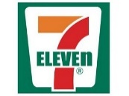
WHAT DIFFERENTIATES YOUR SHOPPERS SHOPPING CHOICES?
Destination Items
Weekend/Weekday
NARTD
Seafood
Fresh Meat
CSD
Hardware
Weekday
Weekend
Index v _base1_
Index v _base1_
Index v _base1_
Index v _base1_
Index v _base1_
81.9%
18.1%
175
85
85
6.1%
127
2.5%
139
Index v _base1_
105
Index v _base1_
83
22.8%
Index v _base2_
42.1%
Index v _base2_
26.5%
Index v _base2_
Index v _base2_
Index v _base2_
178
94
75
161
86
Index v _base2_
111
Index v _base2_
69
Impulse Items
NARTD
Seafood
Fresh Meat
CSD
Hardware
Smartphone/ Tablet influenced Purchase
Index v _base1_
Index v _base1_
Index v _base1_
Index v _base1_
Index v _base1_
17.9%
175
85
85
127
139
22.8%
Index v _base2_
42.1%
Index v _base2_
26.5%
Index v _base2_
6.1%
Index v _base2_
2.5%
Index v _base2_
Index v _base1_
72
178
94
75
161
86
Index v _base2_
85
Check-Out Method
Used Self-Checkout
Store Employee Rang Up Purchases
Average check size
Index v _base1_
86
_base1_ - _val1_
25.3%
53.7%
Index v _base1_
185
$6.51
Index v _base2_
66
Index v _base2_
258
_base2_ - _val2_
Note: Significantly high / Significantly low
Source: iShop
Time Period: _timeperiod_ | Freq – _frequency_

Slide 19







HOW SATISFIED IS YOUR SHOPPER WITH THE VISIT?
Overall Satisfaction
Satisfaction Drivers (Top two)
Product Selection
97.2%
Product Pricing
88.1%
Very Satisfied
Index v _base1_
Index v _base1_
101
106
Index v _base2_
Index v _base2_
102
108
79.5%
Service
94.1%
Checkout Experience
90.2%
Index v _base1_
Index v _base1_
104
103
Index v _base2_
Index v _base2_
108
106
Index v _base1_
113
Atmosphere
83.7%
Ease of Shopping
87.5%
Index v _base2_
Index v _base1_
Index v _base1_
117
107
100
Index v _base2_
Index v _base2_
103
106
Note: Significantly high / Significantly low
Source: iShop
Time Period: _timeperiod_ | Freq – _frequency_

Slide 20
Channel Performance & Customer Trends
Retailer shopper Deep Dive
Who is the retailer’s shopper?
Path To Purchase and Trip Details
Frequency Shares
Strengths & Opportunities
Beverage Section

Slide 21





HOW OFTEN DO THEY VISIT? – SHOPPERS FREQUENCY FUNNEL (TRADE AREA BASE)
\\
7-Eleven
Average Competitive Set
Conversion
Conversion
19.2%
15.5%
78.1%
72.1%
69.3%
60.9%
Competitive Set –
Source: iShop
Time Period: _timeperiod_ | Freq – _frequency_

Slide 22

HOW OFTEN DO THEY VISIT? (SHOPPER AND TRIP SHARE FOR _retailer_ AND COMPETITOR SET)
\\
Note: Yearly+ Base for shopper Frequencies
Competitive Set –
Source: iShop
Time Period: _timeperiod_ | Freq – _frequency_

Slide 23
Channel Performance & Customer Trends
Retailer shopper Deep Dive
Who is the retailer’s shopper?
Path To Purchase and Trip Details
Frequency Shares
Strengths & Opportunities
Beverage Section

Slide 24






Strengths & Opportunities
versus

Slide 25
WHAT PERCEPTION DOES SHOPPERS HAVE OF YOUR BRAND?
\\
 | 7-Eleven | Alberstons | ALDI | Circle K | Costco | CVS | Sam’s Club
Has Good Coupon Policy | 6.6% | 5.6% | 5.0% | 4.0% | 4.4% | 8.4% | 6.5%
Has Good Fuel Prices | 23.6% | 55.1% | 43.1% | 59.2% | 53.8% | 61.0% | 1.4%
Has Good Sales | 11.4% | 8.0% | 7.2% | 9.1% | 7.7% | 10.8% | 54.0%
Has Low Everyday Prices | 13.7% | 11.7% | 9.0% | 16.7% | 9.7% | 11.2% | 74.4%
Provides Good Overall Value | 19.9% | 25.2% | 17.6% | 33.2% | 21.7% | 24.2% | 76.1%
Carries High-Quality Products | 14.4% | 21.8% | 11.6% | 25.1% | 18.1% | 16.5% | 45.7%
Has Good Selection | 20.3% | 24.1% | 16.9% | 29.1% | 19.9% | 17.4% | 49.4%
Offers Unique Appealing Products | 12.5% | 19.4% | 8.3% | 17.7% | 12.6% | 9.6% | 51.3%
Rarely Runs Out Of Stock | 20.5% | 28.8% | 16.1% | 32.1% | 17.1% | 17.4% | 28.5%
Has Clean Shopping Area | 29.8% | 48.2% | 29.2% | 54.1% | 38.1% | 35.6% | 63.5%
Has A Pharmacy I Trust | 2.6% | 3.0% | 2.1% | 1.0% | 0.7% | 1.1% | 1.2%
Has Clean Restrooms | 10.6% | 37.9% | 15.7% | 50.0% | 31.4% | 22.3% | 28.6%
Has Good, Safe Parking Facilities | 27.3% | 52.5% | 29.7% | 50.7% | 36.4% | 37.0% | 68.5%
Is A Store I Trust | 30.7% | 51.5% | 27.3% | 48.8% | 31.5% | 36.8% | 67.1%
Is Family-Friendly | 25.5% | 45.1% | 26.2% | 40.2% | 30.9% | 28.8% | 57.9%
Has Friendly, Comfortable Atmosphere | 23.3% | 50.2% | 23.1% | 46.6% | 29.0% | 28.5% | 52.9%
Is A Fun Place To Shop | 15.1% | 15.2% | 8.8% | 24.3% | 12.6% | 12.0% | 38.8%
Has A Familiar Layout | 35.5% | 48.6% | 30.7% | 47.7% | 35.3% | 36.8% | 61.3%
Has Easy, Quick Checkout Experience | 38.2% | 44.7% | 34.5% | 53.7% | 38.9% | 37.4% | 45.1%
Has Convenient Hours | 55.0% | 57.0% | 49.0% | 64.6% | 51.5% | 55.0% | 44.4%
Has Items Frequently Buy In Convenient Location | 32.7% | 41.5% | 30.5% | 42.7% | 29.1% | 32.8% | 54.7%
Good Place To Grab Quick Meal, Beverage, Snack | 59.6% | 73.0% | 51.3% | 71.1% | 55.0% | 59.9% | 10.9%
Is Conveniently Located | 51.5% | 61.5% | 50.2% | 57.0% | 44.4% | 52.0% | 64.2%
Is Easy To Get In And Out Of Quickly | 52.3% | 62.8% | 49.3% | 62.9% | 51.9% | 53.9% | 49.8%
Is Well-Organised/Easy To Shop | 32.2% | 39.8% | 28.5% | 45.9% | 35.1% | 32.1% | 61.1%
Offers One-Stop Shopping | 14.5% | 13.2% | 12.2% | 15.8% | 8.3% | 12.1% | 24.9%
Has Good Loyalty Program | 16.7% | 10.7% | 11.9% | 11.2% | 16.2% | 50.5% | 2.3%
Has Good Customer Service Policies | 8.9% | 11.8% | 6.2% | 11.8% | 5.5% | 6.8% | 32.7%
Has Helpful, Courteous, Knowledgeable Employees | 19.2% | 35.8% | 17.7% | 41.7% | 22.3% | 25.7% | 42.8%
Has Product Demonstrations/Product Samples | 4.7% | 5.2% | 2.6% | 3.9% | 2.5% | 2.6% | 3.8%
None Of These | 11.9% | 6.0% | 13.7% | 6.9% | 12.2% | 6.2% | 3.8%
Source: iShop
Time Period: _timeperiod_ | Freq – _frequency_

Slide 26
WHAT ARE THE PERCEPTUAL STRENGTH & OPPORTUNITIES OF YOUR OUTLET?
\\
 | 7-Eleven | Alberston’s | ALDI | Circle K | Costco | CVS | Sam’s Club
Has Good Coupon Policy | 6.5% | -3.4% | 6.7% | -7.0% | 2.9% | 5.0% | -10.6%
Has Good Fuel Prices | -13.2% | 9.5% | 8.1% | 11.5% | 15.6% | 20.9% | -52.4%
Has Good Sales | 1.6% | -10.7% | -0.8% | -11.6% | -3.5% | -2.3% | 27.2%
Has Low Everyday Prices | -1.5% | -12.4% | -4.5% | -9.5% | -7.0% | -7.3% | 42.1%
Provides Good Overall Value | -5.6% | -9.1% | -6.1% | -3.2% | -5.2% | -4.5% | 33.7%
Carries High-Quality Products | -1.8% | -3.3% | -2.8% | -2.0% | 0.5% | -3.0% | 12.5%
Has Good Selection | 0.7% | -4.3% | -1.0% | -1.5% | -1.1% | -5.5% | 12.7%
Offers Unique Appealing Products | -0.6% | -2.6% | -3.1% | -6.3% | -1.9% | -6.8% | 21.2%
Rarely Runs Out Of Stock | 3.3% | 2.7% | 0.6% | 3.9% | -1.5% | -3.1% | -5.8%
Has Clean Shopping Area | -7.2% | 2.4% | -6.0% | 6.2% | -0.3% | -4.7% | 9.5%
Has A Pharmacy I Trust | 6.5% | -1.9% | 7.9% | -5.9% | 3.3% | 1.8% | -11.8%
Has Clean Restrooms | -11.8% | 6.7% | -4.9% | 16.7% | 7.6% | -3.4% | -10.8%
Has Good, Safe Parking Facilities | -10.2% | 6.2% | -6.0% | 2.3% | -2.4% | -3.8% | 14.0%
Is A Store I Trust | -5.6% | 6.3% | -7.2% | 1.6% | -6.2% | -2.7% | 13.8%
Is Family-Friendly | -5.2% | 5.6% | -2.7% | -1.4% | -1.2% | -5.2% | 10.2%
Has Friendly, Comfortable Atmosphere | -7.3% | 10.8% | -5.7% | 5.1% | -3.0% | -5.4% | 5.4%
Is A Fun Place To Shop | 2.6% | -6.1% | -1.9% | 0.9% | -1.2% | -3.7% | 9.4%
Has A Familiar Layout | -1.1% | 3.1% | -4.1% | 0.2% | -2.7% | -3.1% | 7.7%
Has Easy, Quick Checkout Experience | 2.1% | -0.2% | 0.2% | 6.6% | 1.4% | -2.0% | -8.1%
Has Convenient Hours | 6.9% | 0.0% | 2.7% | 5.6% | 2.0% | 3.6% | -20.7%
Has Items Frequently Buy In Convenient Location | 0.7% | 0.6% | 0.3% | -0.2% | -4.4% | -2.5% | 5.6%
Good Place To Grab Quick Meal, Beverage, Snack | 10.9% | 15.4% | 4.3% | 11.5% | 4.9% | 7.9% | -54.9%
Is Conveniently Located | 2.8% | 3.9% | 3.2% | -2.7% | -5.7% | 0.0% | -1.6%
Is Easy To Get In And Out Of Quickly | 3.3% | 4.9% | 2.1% | 3.0% | 1.4% | 1.5% | -16.2%
Is Well-Organised/Easy To Shop | -1.4% | -2.6% | -3.3% | 1.4% | 0.1% | -4.7% | 10.5%
Offers One-Stop Shopping | 5.7% | -4.4% | 5.2% | -3.8% | -1.9% | 0.1% | -0.9%
Has Good Loyalty Program | 5.3% | -9.6% | 2.3% | -11.1% | 3.4% | 35.8% | -26.1%
Has Good Customer Service Policies | 2.6% | -3.4% | 1.7% | -5.4% | -2.2% | -2.8% | 9.4%
Has Helpful, Courteous, Knowledgeable Employees | -4.4% | 3.3% | -4.1% | 7.1% | -2.8% | -1.2% | 2.2%
Has Product Demonstrations/Product Samples | 6.8% | -1.6% | 6.4% | -5.0% | 3.2% | 1.3% | -11.1%
None Of These | 8.9% | -5.8% | 12.4% | -7.0% | 7.8% | -0.1% | -16.2%
Note: Strength >_m_ / Weakness < _mn_
Source: iShop
Time Period: _timeperiod_ | Freq – _frequency_

Slide 27
WHAT PERCEPTION DOES SHOPPERS HAVE OF YOUR BRAND (GOOD PLACE TO SHOP IMAGERIES)?
\\
 | 7-Eleven | Alberstons | ALDI | Circle K | Costco | CVS | Sam’s Club
ALCOHOLIC BEVERAGES | 20.4% | 34.3% | 15.0% | 23.8% | 50.9% | 13.4% | 34.7%
CARBONATED SOFT DRINKS | 57.7% | 50.1% | 31.7% | 54.7% | 49.7% | 43.8% | 47.3%
COLD BEVERAGES TO CONSUME IMMEDIATELY | 74.9% | 34.1% | 13.8% | 72.4% | 25.2% | 46.4% | 26.3%
HOT COFFEE | 50.7% | 10.4% | 1.8% | 47.3% | 8.0% | 2.0% | 6.0%
NON-ALCOHOLIC NON-CARBONATED BEVERAGES | 46.0% | 56.3% | 45.7% | 41.9% | 66.2% | 39.3% | 60.1%
DAIRY PRODUCTS AND EGGS | 9.8% | 64.4% | 67.9% | 7.2% | 62.7% | 12.3% | 50.5%
DELI ITEMS | 7.2% | 58.8% | 15.5% | 4.3% | 35.6% | 2.1% | 29.0%
FRESH BAKED GOODS | 8.7% | 57.5% | 9.4% | 5.0% | 60.0% | 1.7% | 47.2%
FRESH FRUITS AND VEGETABLES | 3.9% | 65.7% | 62.4% | 2.1% | 59.1% | 1.6% | 46.7%
FRESH MEATS, POULTRY, AND SEAFOOD | 2.6% | 63.5% | 40.0% | 1.9% | 72.2% | 1.5% | 59.4%
READY-TO-EAT OR HEAT FOODS SUCH AS ROTISSERIE CHICKEN, PREPARED ENTREES, OR SIDE DISHES | 14.2% | 53.4% | 5.3% | 8.9% | 71.2% | 2.2% | 56.4%
REFRIGERATED OR FROZEN FOODS | 12.7% | 66.1% | 63.0% | 8.1% | 80.0% | 10.7% | 70.4%
CANDY, GUM, OR MINTS | 59.8% | 40.6% | 30.7% | 53.8% | 35.6% | 62.0% | 36.1%
SNACK FOODS | 62.0% | 50.7% | 58.4% | 54.9% | 60.8% | 50.9% | 55.4%
BABY FOOD AND BABY CARE ITEMS | 3.1% | 18.7% | 9.7% | 2.7% | 22.5% | 17.4% | 19.6%
COSMETICS AND PERSONAL CARE SUCH AS RAZORS, SHAMPOO, ETC. | 5.1% | 19.7% | 7.0% | 3.3% | 46.1% | 66.6% | 35.4%
GASOLINE/DIESEL | 33.5% | 5.4% | 0.6% | 58.4% | 76.1% | 1.0% | 57.6%
NON-GROCERY PRODUCTS SUCH AS CLOTHING, HOUSEWARES, TOYS, GREETING CARDS, ETC. | 3.6% | 8.4% | 7.9% | 2.4% | 55.2% | 23.6% | 42.0%
OVER-THE-COUNTER MEDICATIONS/FIRST-AID | 6.5% | 24.2% | 5.0% | 5.2% | 38.5% | 81.0% | 29.0%
PAPER GOODS AND CLEANING PRODUCTS | 7.1% | 28.8% | 29.4% | 4.9% | 76.5% | 33.7% | 66.9%
PET FOOD AND PET CARE ITEMS | 3.9% | 18.5% | 9.7% | 2.8% | 36.2% | 8.5% | 32.9%
PRESCRIPTION DRUGS AND PHARMACY ITEMS | 2.0% | 20.6% | 0.9% | 1.6% | 37.9% | 81.1% | 23.9%
STORE BRAND/PRIVATE LABEL PRODUCTS | 9.1% | 46.0% | 53.6% | 5.5% | 67.2% | 29.6% | 48.9%
OTHER SERVICES (BANK, VIDEO RENTAL, EVENT TICKETS, ETC.) | 5.8% | 15.6% | 1.0% | 4.1% | 13.0% | 5.6% | 5.7%
NONE OF THESE | 9.0% | 9.5% | 8.8% | 10.7% | 2.0% | 4.3% | 5.5%
Source: iShop
Time Period: _timeperiod_ | Freq – _frequency_

Slide 28
WHAT ARE THE PERCEPTUAL STRENGTH & OPPORTUNITIES OF YOUR OUTLET (GOOD PLACE TO SHOP IMAGERIES)?
\\
 | 7-Eleven | Alberston’s | ALDI | Circle K | Costco | CVS | Sam’s Club
ALCOHOLIC BEVERAGES | 2.8% | 0.6% | -5.6% | 7.5% | 5.8% | -9.2% | -1.8%
CARBONATED SOFT DRINKS | 19.7% | -4.0% | -9.2% | 18.0% | -15.8% | 0.9% | -9.6%
COLD BEVERAGES TO CONSUME IMMEDIATELY | 42.9% | -14.0% | -21.2% | 41.7% | -34.4% | 9.5% | -24.6%
HOT COFFEE | 42.5% | -13.8% | -9.3% | 40.4% | -27.7% | -11.0% | -21.1%
NON-ALCOHOLIC NON-CARBONATED BEVERAGES | 5.1% | -0.6% | 1.8% | 2.2% | -2.3% | -6.5% | 0.2%
DAIRY PRODUCTS AND EGGS | -19.6% | 19.0% | 35.6% | -20.9% | 5.7% | -22.0% | 2.2%
DELI ITEMS | -4.7% | 30.9% | 0.6% | -6.3% | -3.8% | -14.7% | -1.9%
FRESH BAKED GOODS | -8.5% | 24.2% | -10.8% | -10.9% | 15.3% | -20.3% | 11.1%
FRESH FRUITS AND VEGETABLES | -20.7% | 25.0% | 34.8% | -21.2% | 7.0% | -28.0% | 3.1%
FRESH MEATS, POULTRY, AND SEAFOOD | -21.9% | 22.8% | 12.5% | -21.4% | 20.1% | -28.0% | 15.9%
READY-TO-EAT OR HEAT FOODS SUCH AS ROTISSERIE CHICKEN, PREPARED ENTREES, OR SIDE DISHES | -6.1% | 17.0% | -18.0% | -10.2% | 23.3% | -23.0% | 17.1%
REFRIGERATED OR FROZEN FOODS | -21.9% | 15.5% | 25.5% | -25.2% | 17.9% | -28.7% | 16.9%
CANDY, GUM, OR MINTS | 24.2% | -11.1% | -7.9% | 19.5% | -27.6% | 21.4% | -18.5%
SNACK FOODS | 15.8% | -11.6% | 9.1% | 9.9% | -13.0% | -0.3% | -9.8%
BABY FOOD AND BABY CARE ITEMS | -0.4% | -0.8% | 3.2% | 0.4% | -8.6% | 9.0% | -2.8%
COSMETICS AND PERSONAL CARE SUCH AS RAZORS, SHAMPOO, ETC. | -11.2% | -12.6% | -12.3% | -11.7% | 2.2% | 45.4% | 0.1%
GASOLINE/DIESEL | 10.2% | -34.0% | -25.7% | 36.3% | 25.2% | -27.2% | 15.3%
NON-GROCERY PRODUCTS SUCH AS CLOTHING, HOUSEWARES, TOYS, GREETING CARDS, ETC. | -7.0% | -18.2% | -5.6% | -6.9% | 17.1% | 8.1% | 12.5%
OVER-THE-COUNTER MEDICATIONS/FIRST-AID | -10.7% | -9.0% | -15.1% | -10.7% | -6.3% | 58.9% | -7.1%
PAPER GOODS AND CLEANING PRODUCTS | -18.3% | -12.7% | 0.9% | -19.2% | 23.5% | 3.3% | 22.5%
PET FOOD AND PET CARE ITEMS | -2.3% | -3.7% | 0.5% | -2.1% | 2.5% | -2.6% | 7.8%
PRESCRIPTION DRUGS AND PHARMACY ITEMS | -12.1% | -9.6% | -16.2% | -11.3% | -3.8% | 62.1% | -9.2%
STORE BRAND/PRIVATE LABEL PRODUCTS | -18.1% | 2.7% | 23.3% | -20.5% | 12.4% | -2.6% | 2.8%
OTHER SERVICES (BANK, VIDEO RENTAL, EVENT TICKETS, ETC.) | 8.5% | 2.2% | 0.6% | 8.0% | -11.9% | 3.3% | -10.6%
NONE OF THESE | 11.8% | -3.8% | 8.6% | 14.7% | -22.8% | 2.2% | -10.7%
Note: Strength >_m_ / Weakness < _mn_
Source: iShop
Time Period: _timeperiod_ | Freq – _frequency_

Slide 29
WHAT PERCEPTIONS ARE MOST IMPORTANT TO REGULAR (MONTHLY+) SHOPPERS OF THE COMPETITIVE SET?
Average Imagery Difference – Monthly+ shoppers vs. Total Market (Trade Area)
Has Good Coupon Policy | 189
Has Good Fuel Prices | 182
Has Good Sales | 179
Has Low Everyday Prices | 173
Provides Good Overall Value | 168
Carries High-Quality Products | 163
Has Good Selection | 158
Offers Unique Appealing Products | 153
Rarely Runs Out Of Stock | 148
Has Clean Shopping Area | 143
Has A Pharmacy I Trust | 138
Has Clean Restrooms | 133
Has Good, Safe Parking Facilities | 128
Is A Store I Trust | 123
Is Family-Friendly | 118
Has Friendly, Comfortable Atmosphere | 113
Is A Fun Place To Shop | 108
Has A Familiar Layout | 103
Has Easy, Quick Checkout Experience | 98
Has Convenient Hours | 93
Has Items Frequently Buy In Convenient Location | 88
Good Place To Grab Quick Meal, Beverage, Snack | 83
Is Conveniently Located | 78
Is Easy To Get In And Out Of Quickly | 73
Is Well-Organised/Easy To Shop | 68
Offers One-Stop Shopping | 63
Has Good Loyalty Program | 58
Has Good Customer Service Policies | 53
Has Helpful, Courteous, Knowledgeable Employees | 48
Has Product Demonstrations/Product Samples | 43
Relatively Higher Among Monthly+ shoppers
Relatively Lower Among Monthly+ shoppers
Time Period: _timeperiod_ | Freq – _frequency_

Slide 30

COMBINING ‘FAIR SHARE’ PERFORMANCE WITH ‘IMAGERY LIFT’ IMPORTANCE HELPS US FOCUS ON KEY OPPORTUNITIES
More Important And Weak
Performance
Improve
More Important And Strong Performance
Protect
Average
Average
Less Important And Weak
Performance
Ignore
Less Important And Strong Performance
Protect
Note: Strength > / Weakness <
Time Period: _timeperiod_
3%
- 3%

Slide 31
Channel Performance & Customer Trends
Retailer shopper Deep Dive
Who is the retailer’s shopper?
Path To Purchase and Trip Details
Frequency Shares
Strengths & Opportunities
Beverage Section

Slide 32
Beverage Section

Slide 33
WHAT ARE THE KEY BEVERAGE CATEGORIES PURCHASED?
Top In-Store Beverage Categories and Their YOY Change
Note: Significantly high / Significantly low
Source: iShop
Time Period: _timeperiod_ | Freq – _frequency_

Slide 34







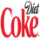











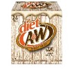

WHAT ARE THE TOP BEVERAGE BRANDS AMONG THE KEY CATEGORIES?
Top In-Store Beverage Brands for _retailer_
SSD Regular
SSD Diet
RTD Coffee
Brands |  | Index V. _base1_ | Index V. _base2_
 | _metric_ | 95 | 106
 | _metric_ | 86 | 94
 | _metric_ | 90 | 98
 | _metric_ | 88 | 96
 | _metric_ | 86 | 95
Brands |  | Index V. _base1_ | Index V. _base2_
 | _metric_ | 95 | 106
 | _metric_ | 86 | 94
 | _metric_ | 90 | 98
 | _metric_ | 88 | 96
 | _metric_ | 86 | 95
Brands |  | Index V. _base1_ | Index V. _base2_
 | _metric_ | 95 | 106
 | _metric_ | 86 | 94
 | _metric_ | 90 | 98
 | _metric_ | 88 | 96
 | _metric_ | 86 | 95
Note: Significantly high / Significantly low
Source: iShop
Time Period: _timeperiod_ | Freq – _frequency_

Slide 35
HOW DO THE KEY BEVERAGE MANUFACTURERS PERFORM?
Top In-Store Manufactures Net for _retailer_
Note: Significantly high / Significantly low
Source: iShop
Time Period: _timeperiod_ | Freq – _frequency_

Slide 36
WHAT ARE THE KEY BEVERAGE PACKAGES PURCHASED?
Top In-Store Beverage Ingredients for _retailer_
Note: Significantly high / Significantly low
Source: iShop
Time Period: _timeperiod_ | Freq – _frequency_

Slide 37
Where Are Beverages Purchased In-Store?
Beverage Temperature & Location for _retailer_
Trip Share & Gap v YAGO
Total
SSD
Still
% change Vs Prior
25%
50%
15%
Chilled
Index vs Convenience | 87 | 78 | 34 | 106 | 133 | 94 | 56 | 66
% change Vs Prior
25%
50%
15%
Ambient
Index vs Convenience | 86 | 43 | 32 | 24 | N/A
Note: Significantly high / Significantly low
Source: iShop
Time Period: _timeperiod_

Slide 38
Thank You!

Slide 39
Appendix
(Best in Class Comparison for Imageries)

Slide 40





IMAGERY SNAPSHOT: _retailer_ VS COMPETITION – ESTABLISHMENT IN TRADE AREA
Best-In-Class
Establishment
Rating
Products
46.9%
39.0%
38.6%
26.4%
26.4%
52.0%
46.9%
41.2%
Convenience
40.0%
36.8%
31.4%
30.4%
16.7%
16.7%
Source: iShop
Time Period: _timeperiod_

Slide 41









IMAGERY SNAPSHOT: _retailer_ VS COMPETITION - ESTABLISHMENT IN TRADE AREA
Best-In-Class
Establishment
Rating
59.9%
58.4%
Atmosphere
26.3%
45.5%
42.1%
40.9%
63.9%
Value
22.4%
57.0%
44.3%
24.7%
Service
44.5%
16.7%
16.7%
Other
16.7%
16.7%
Source: iShop
Time Period: _timeperiod_

